Slide 1
SC2001 LAB 3
Team 4 Low Jia Qi Low Wei Jie Luke Eng Peng Kee

Slide 2
Contents of Project 3 - Dynamic Programming
Recursive Definition
Subproblem Graph
Algorithm
(Implementation + Results)

Slide 3
Recursive Definition

Slide 4
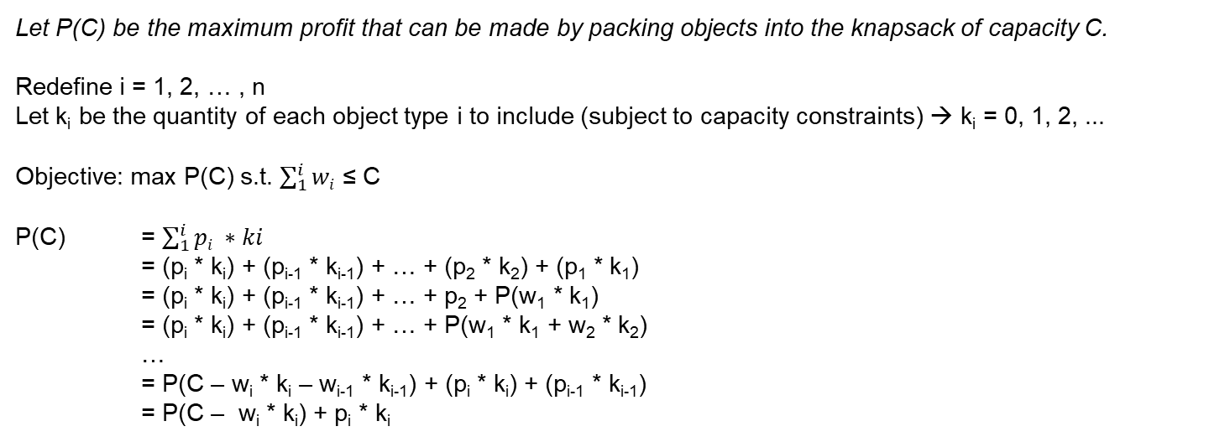
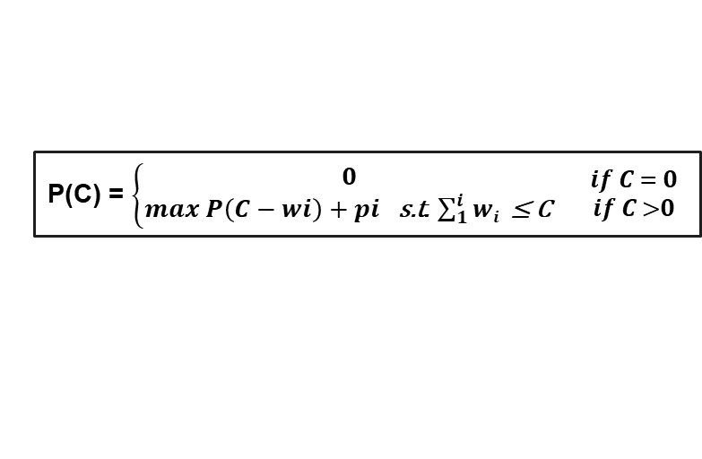
Recursive Definition
We have a knapsack of capacity weight C (a positive integer) and n types of objects. Each object of the i^{th} type has weight w_{i} and profit p_{i} (all w_{i} and all p_{i} are positive integers, i = 0, 1, …, n-1). There are unlimited supplies of each type of objects. Find the largest total profit of any set of the objects that fits in the knapsack.
Let P(C) be the maximum profit that can be made by packing objects into the knapsack of capacity C.
Redefine i = 1, 2, … , n
Let k_{i} be the quantity of each object type i to include (subject to capacity constraints) → k_{i} = 0, 1, 2, ...
Objective: max P(C) s.t. $\sum_{1}^{i}{wi}$ ≤ C
P(C) = $\sum_{1}^{i}{pi ∗ki}$
= (p_{i} * k_{i}) + (p_{i-1} * k_{i-1}) + … + (p₂ * k₂) + (p₁ * k₁)
= (p_{i} * k_{i}) + (p_{i-1} * k_{i-1}) + … + p₂ + P(w₁ * k₁)
= (p_{i} * k_{i}) + (p_{i-1} * k_{i-1}) + … + P(w₁ * k₁ + w₂ * k₂)
…
= P(C – w_{i} * k_{i} – w_{i-1} * k_{i-1}) + (p_{i} * k_{i}) + (p_{i-1} * k_{i-1})
= P(C – w_{i} * k_{i}) + p_{i} * k_{i}
P(C) = $\left\{\begin{aligned}0 \\ max P\left(C−wi​\right)+pi \text{s}\text{.}\text{t}\text{. }\sum_{1}^{i}{wi} \text{≤ }\text{C} \end{aligned}\right.$ ${if C = 0 \atop if C >0}$

Slide 5
Subproblem Graph

Slide 6
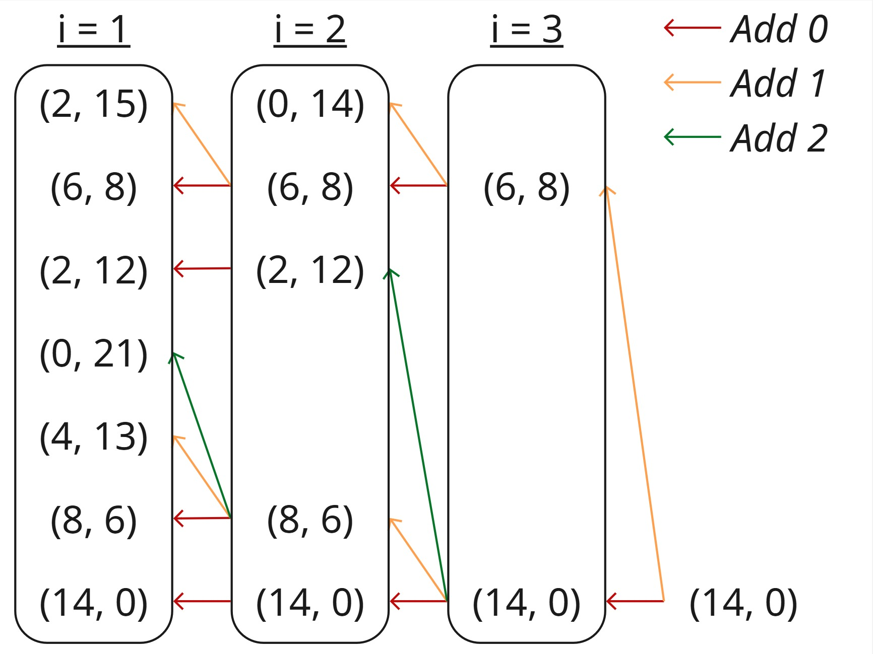
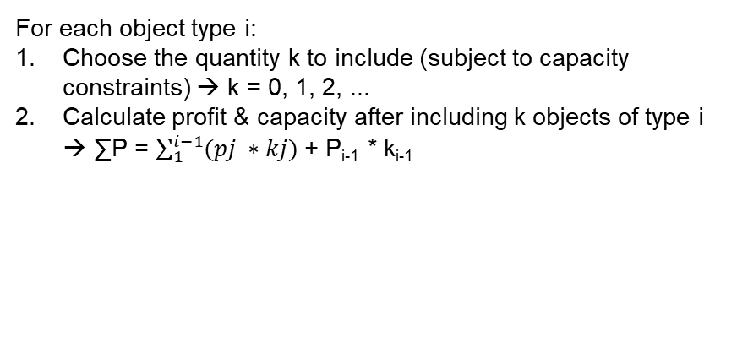
Subproblem Graph
Draw the subproblem graph for P(14) where n is 3 with the weights and profits given below.
i | 1 | 2 | 3
w_{i} | 4 | 6 | 8
p_{i} | 7 | 6 | 9
For each object type i:
Choose the quantity k to include (subject to capacity constraints) → k = 0, 1, 2, ...
Calculate profit & capacity after including k objects of type i → ∑P = $\sum_{1}^{i−1}{(pj ∗kj)}$ + P_{i-1} * k_{i-1}

Slide 7
Algorithm
(Top Down)

Slide 8
Algorithm
def unbounded_knapsack_top_down(n, capacity):
if memo[n][capacity] is not None:
return memo[n][capacity] if n == 0 or capacity == 0:
return 0 if weights[n-1] > capacity:
result = unbounded_knapsack_top_down(n-1, capacity)
else:
include = values[n-1] + unbounded_knapsack_top_down(n, capacity - weights[n-1])
exclude = unbounded_knapsack_top_down(n-1, capacity)
result = max(include, exclude)
memo[n][capacity] = result
return result
Base case 1: return solved (memoized) solution if it exists
Base case 2: 0 profit if 0 capacity
Select maximum profit subject to capacity constraints (see next slide)
Do not add object if adding an additional object of type i exceeds capacity
Choose the higher profit between i) profit obtainable without using object i; and ii) profit from including one additional unit of object i

Slide 9
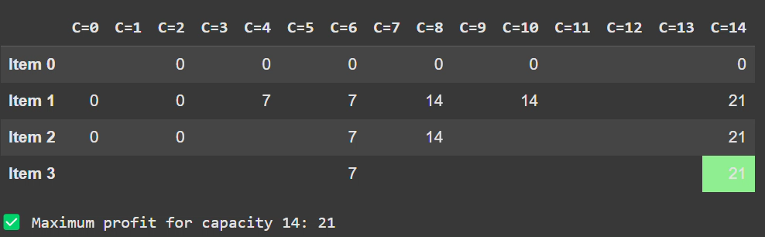
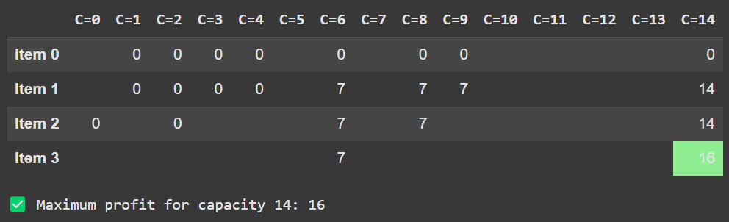
Results
i | 1 | 2 | 3
w_{i} | 4 | 6 | 8
p_{i} | 7 | 6 | 9
i | 1 | 2 | 3
w_{i} | 5 | 6 | 8
p_{i} | 7 | 6 | 9

Slide 10
Algorithm
(Bottom Up)

Slide 11
Algorithm
def unbounded_knapsack_bottom_up(w: list[int], p: list[int], cap: int) -> int:
n = len(w)
dp = [[0] * (cap + 1) for _ in range(n + 1)]
for i in range(1, n + 1):
for c in range(1, cap + 1):
if w[i - 1] > c:
dp[i][c] = dp[i - 1][c] # must be within capacity
else:
# Maximize profit
dp[i][c] = max(dp[i - 1][c], dp[i][c - w[i - 1]] + p[i - 1])
return dp[n][cap]
Initialize matrix containing max profits per object type and capacity
Iterate through capacity (0 to max) per object type
Select maximum profit subject to capacity constraints (see next slide)
Do not add object if adding an additional object of type i exceeds capacity
Choose the higher profit between i) profit obtainable without using object i; and ii) profit from including one additional unit of object i

Slide 12
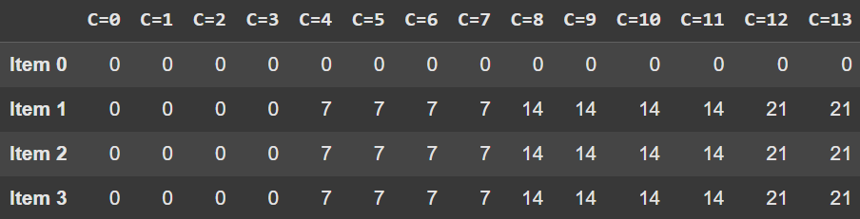
Algorithm
i | 1 | 2 | 3
w_{i} | 4 | 6 | 8
p_{i} | 7 | 6 | 9
e.g. i = 2, C = 8
dp[i - 1][c] = dp[1][8] → max profit obtainable without adding i = 14
max
dp[i][c - w[i - 1]] + p[i - 1] = dp[2][2] + 6 → max profit from adding additional unit of i = 6

Slide 13
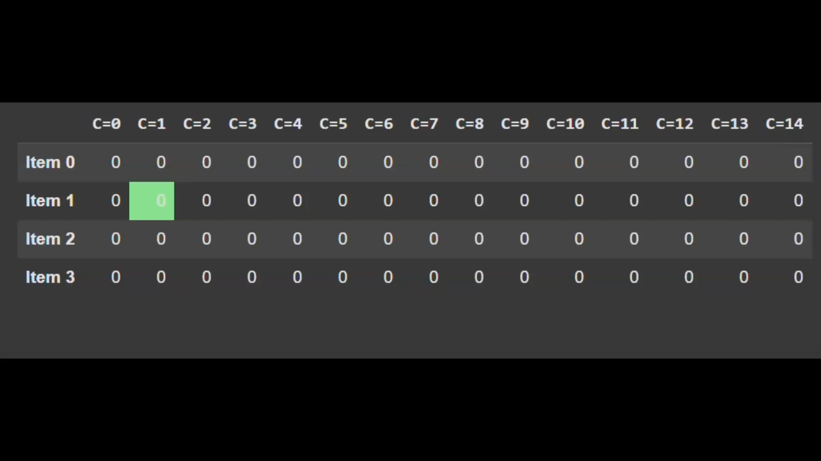
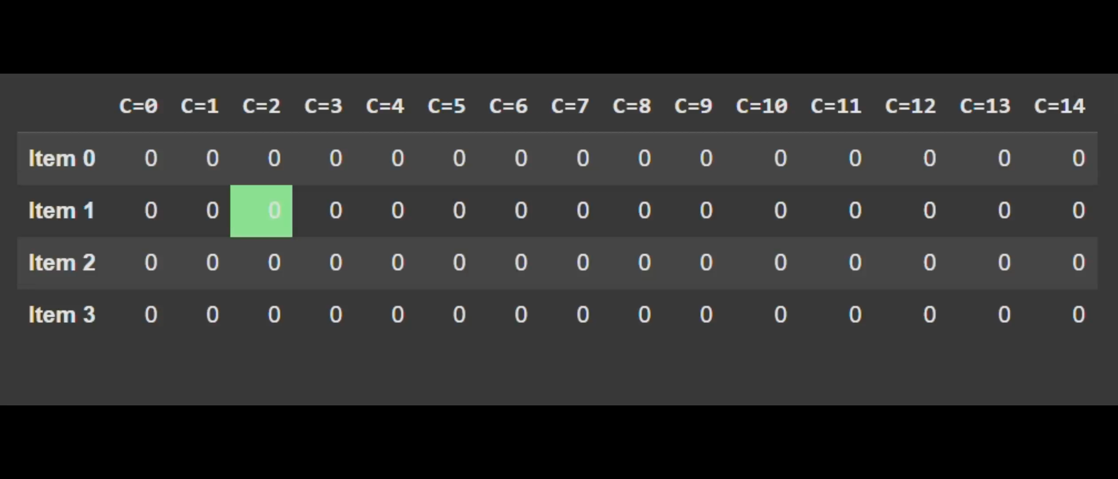
Results
i | 1 | 2 | 3
w_{i} | 4 | 6 | 8
p_{i} | 7 | 6 | 9
i | 1 | 2 | 3
w_{i} | 5 | 6 | 8
p_{i} | 7 | 6 | 9

Slide 14
Thank you!

